Slide 1
Algorithm Trading
Using Quantopian
Raja Harsha Chinta

Slide 2
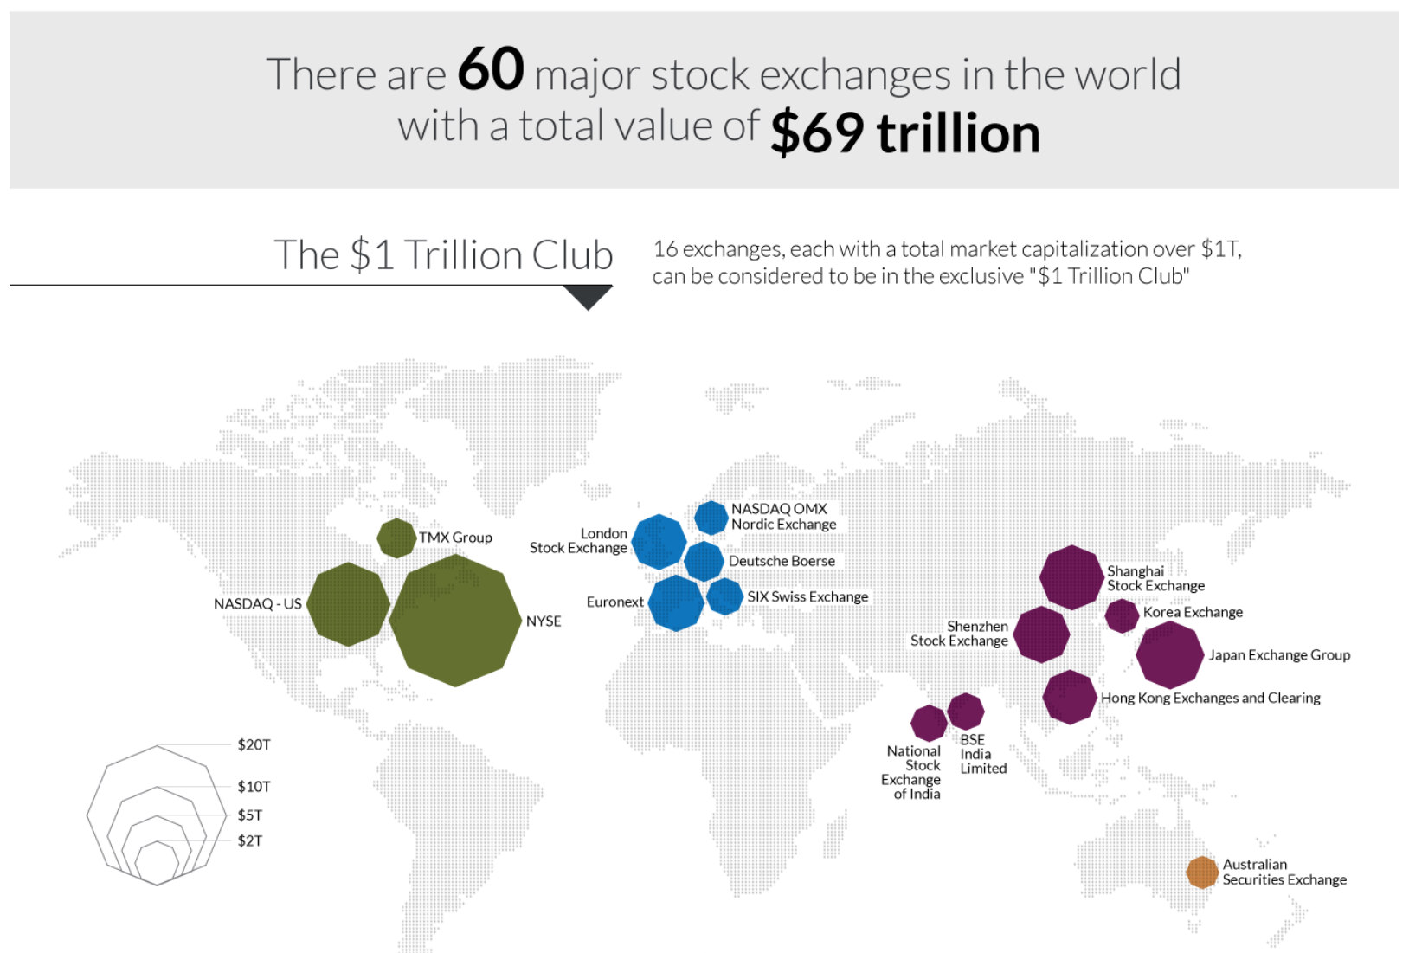

Slide 3
Introduction
Algorithm Trading is set of computer program rules to buy/sell assets.
Great portion of present day Algo-trading is High Frequency Trading (60–73% of all US equity trading volume).
Quantopian provides everything to write these high-quality trading strategies.
It provides Data Sources, IPython Notebook and IDE env. with inbuilt functions.
We can backtest a trading strategy on relevant historical data to ensure its viability before we risk any actual capital.

Slide 4
Basic Methods

Slide 5
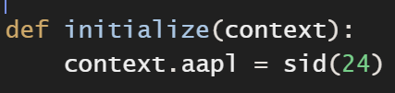

Initial Methods
initialize(context) : Called once at the very beginning of a Backtest.
“sid”: Refers to security id for a particular Stock.
“context”: Dictionary which can be passed to all methods in your algorithm.
handle_data(context, data) : User defined function is called every minute.
before_trading_start(context, data) : Optional. Called daily prior to the open of market. Orders cannot be placed inside this method.

Slide 6
Data Methods
The “data” object: Gives your algorithm a way to fetch all sorts of data.
Get Open, High, Low, Close, Volume (OHLCV) for the current/previous minutes for any asset.
Returns a time series or Data Frame with date as index(usually) and OHLCV fields.
Check if price data of an asset is stale or it can be traded in current minute.
data.history(assets, fields, bar_count, frequency): Returns a window of data for the given assets and fields.
data.current(assets, fields): Returns the current value of the given assets for the given fields at the current algorithm time.

Slide 7
Order Methods
order(asset, amount): Places an order for the specified asset and the specified amount of shares(equities) or contracts(futures).
order_value(asset, amount): Place an order by desired value rather than desired number of shares. Placing a negative order value will result in selling the given value. Orders are always truncated to whole shares or contracts.
Example: Order AAPL worth up to $1000: order_value(symbol(‘AAPL’), 1000).
If the current share price is $105 then 9 shares are ordered to buy.
Partial share would be discarded.
Similarly, we have: order_percent, _target, _target_value, _target_percent

Slide 8
Building Algorithm

Slide 9
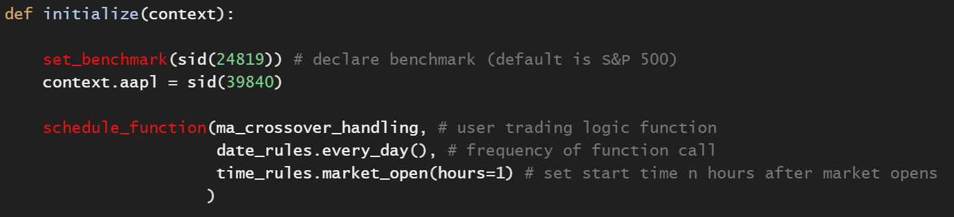
Initializing & Scheduling
“initialize”: Set benchmark for back testing, declare “context” object to access its values in other methods and write scheduling logic.
“schedule_function”: Used to call the user defined trading logic and schedule its execution frequency and also start/end time on a trading day.
Above example sets SPY (S&P 500) as a benchmark and interested to start trading “AAPL” stock every day after one hour of market opens.

Slide 10
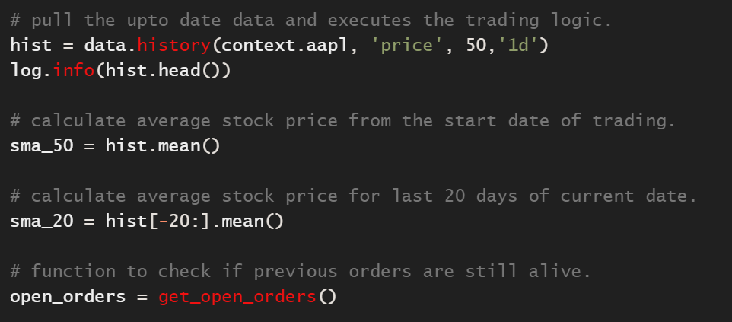
Data Extraction
“data.history”: extracts historical “price” data of “AAPL” stock using “sid” passed through “context” for last n records with frequency 1 day is extracted. We calculated below mean-price for last 50, 20 days as sma_50 & sma_20 resp.
“get_open_orders”: Takes “sid” as input (optional) argument and returns if any open orders exist. A good practice before placing orders to avoid conflicts.

Slide 11
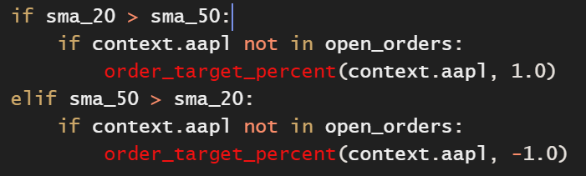
Naïve Trading Logic
A simple trading strategy is based on Moving Average of Stock “Price”.
IF: Avg. Stock Price [ 1 …. N days ] < Avg. Stock Price [ N-20 ….. N days ] : BUY
IF: Avg. Stock Price [ 1 …. N days ] > Avg. Stock Price [ N-20 ….. N days ] : SELL
We check above logic, if no open orders and use “order_target_percent” to place orders to trade. Give % of asset to trade from -1.0 to 1.0. Negative → Sell and Positive → Buy.

Slide 12
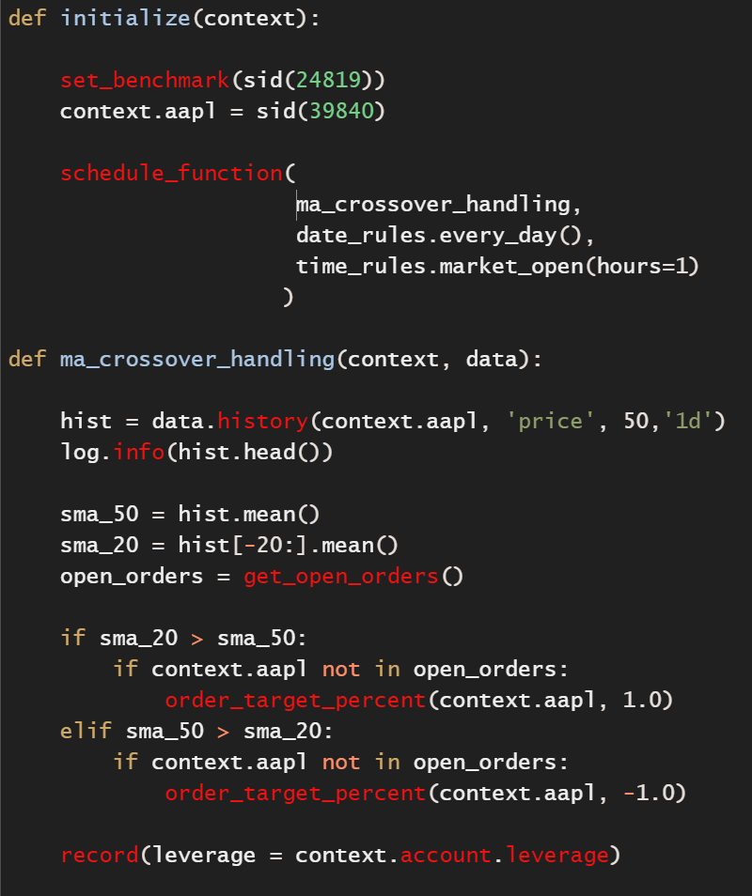
Naive Trading Algorithm
Initialize a benchmark stock and assign user assets to the context.
Extract the historical price data for N previous days/window of a given stock.
Calculate Moving Average of N, N-x days and decide to place Buy/Sell order.
Check for no open orders and place new order.
Run Backtest and observe results to compare trading logic performance with benchmark set.

Slide 13
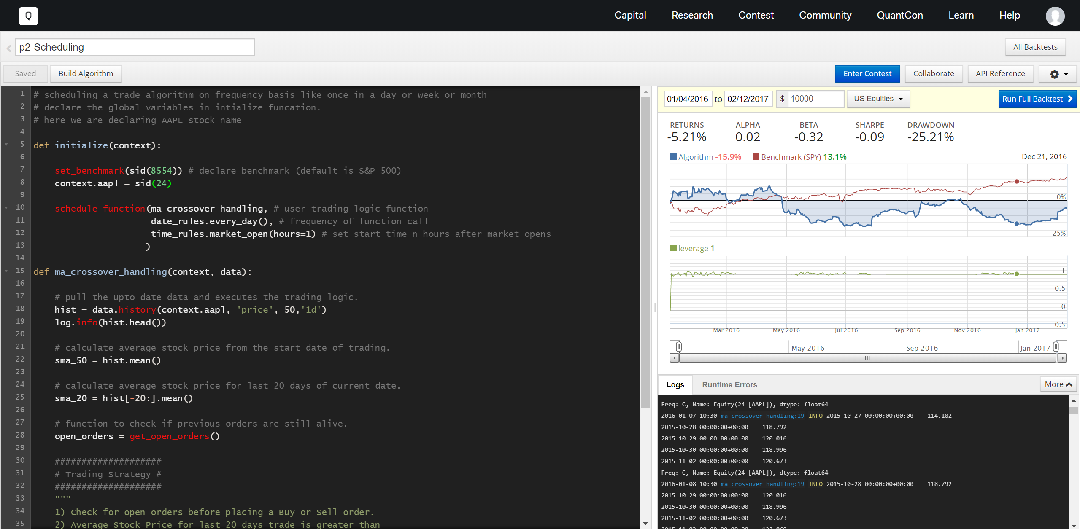
Build Algorithm Results

Slide 14

Backtest Analysis
“Run Full Backtest” runs an event loop handle_data() and generates metrics like deeper risk metrics, position information, transactions, and more.
Common metrics are % Total Returns, Alpha, Beta, Sharpe, % Max Drawdown, etc.
Alphalens is a python library used for performance analysis after predictive stock factors mainly Alpha α.
Pyfolio is also a python library for performance and risk analysis of financial portfolios.
Note: This alphanumeric string can be found in the URL of backtest.

Slide 15
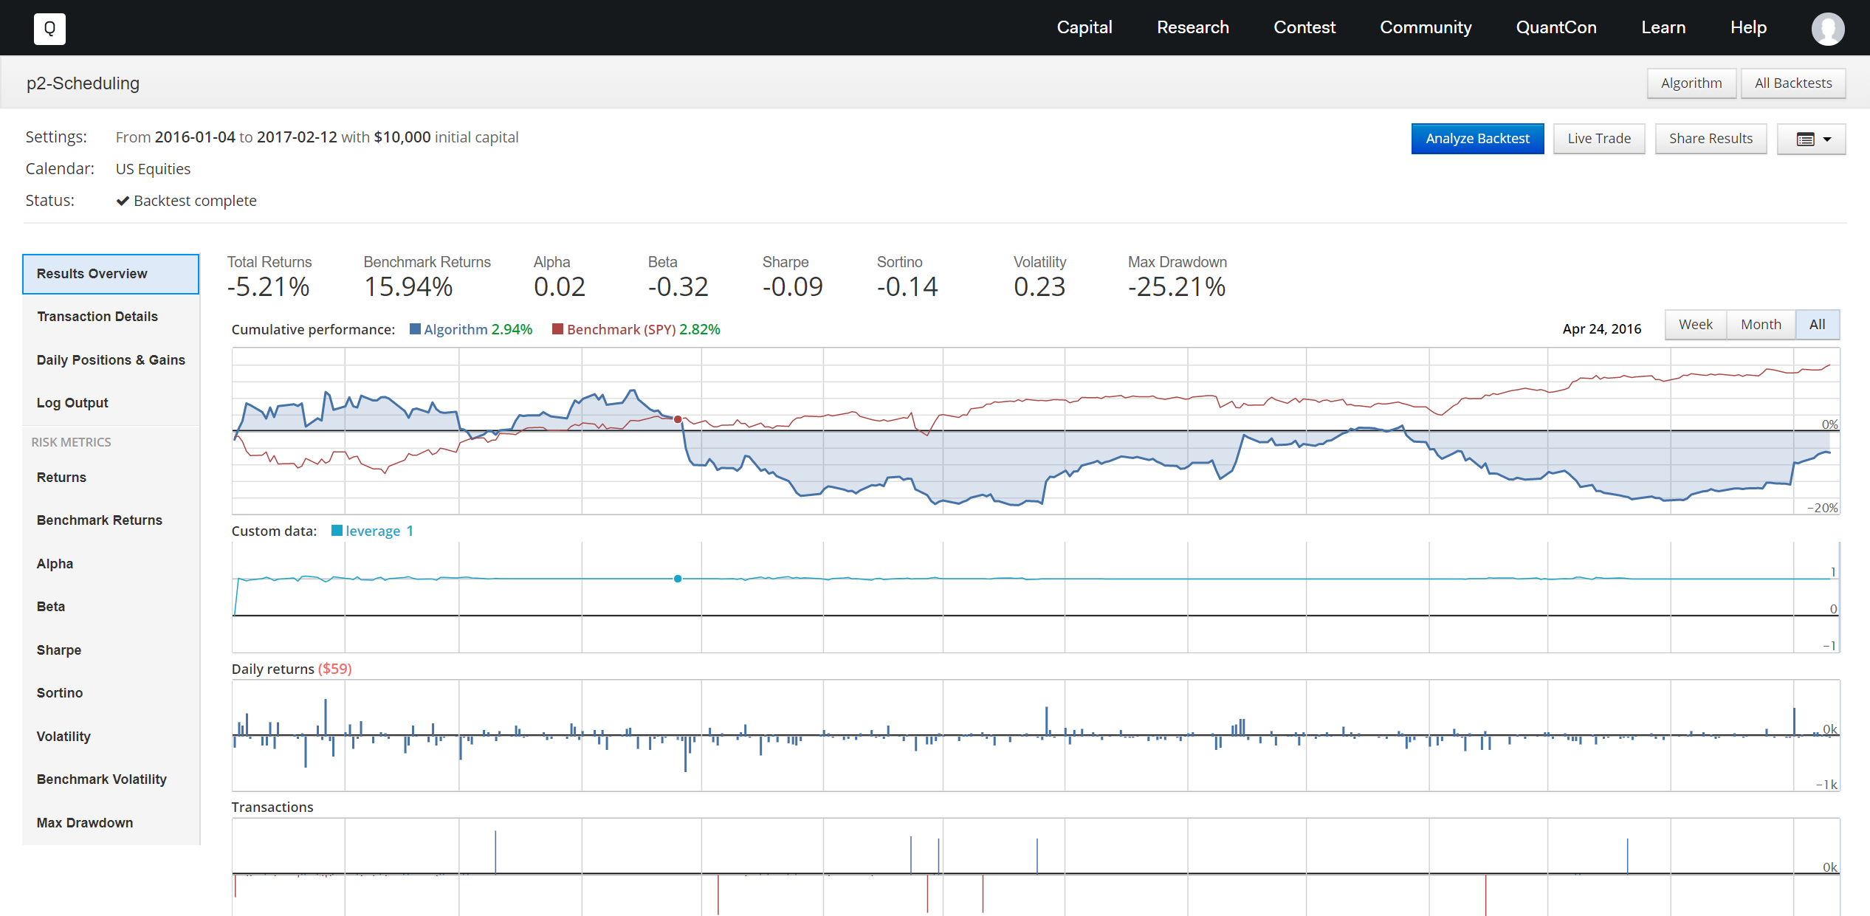
Backtesting Results

Slide 16
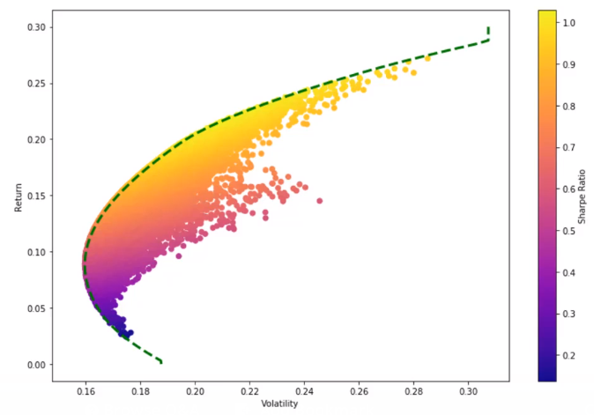
Portfolio Optimization
Guess and check a bunch of random allocations and see which one has best SR.
Monte Carlo Simulation - Randomly Assign a weight to each security in the portfolio and calculate mean daily return and std. Dev. of daily return.
Calculate Sharpe Ratio for thousands of randomly selected allocations and Plot them.
Guessing and checking is not effective, so we use math to find out optimal SR for a given portfolio using optimization algorithms.

Slide 17
Portfolio Allocation & Sharpe-Ratio?
Set of allocations in a variety of securities.
20% in APPL, 30% in FB, 50% in GOOG = 100% Total Asset
Sharpe Ratio is a measure and an industry standard for calculating risk-adjusted return.
Sharpe ratio = (Mean portfolio return − Risk-free rate)/Standard deviation of portfolio return
Risk-free rate ~ 0% in the USA
SR > 1 is evaluated as good allocation, 2 and above are very good allocations

Slide 18
References
Quantopian API Reference: https://www.quantopian.com/help
https://www.investopedia.com/ask/answers/09/high-frequency-trading.asp
http://www.visualcapitalist.com/all-of-the-worlds-stock-exchanges-by-size/

Slide 19
Thank you
Please email your queries to rchin001@odu.edu

